Slide 1
Online Banking Application

Slide 2
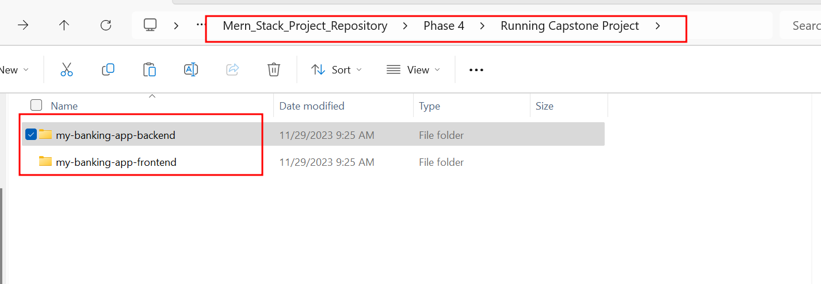
Project structure

Slide 3
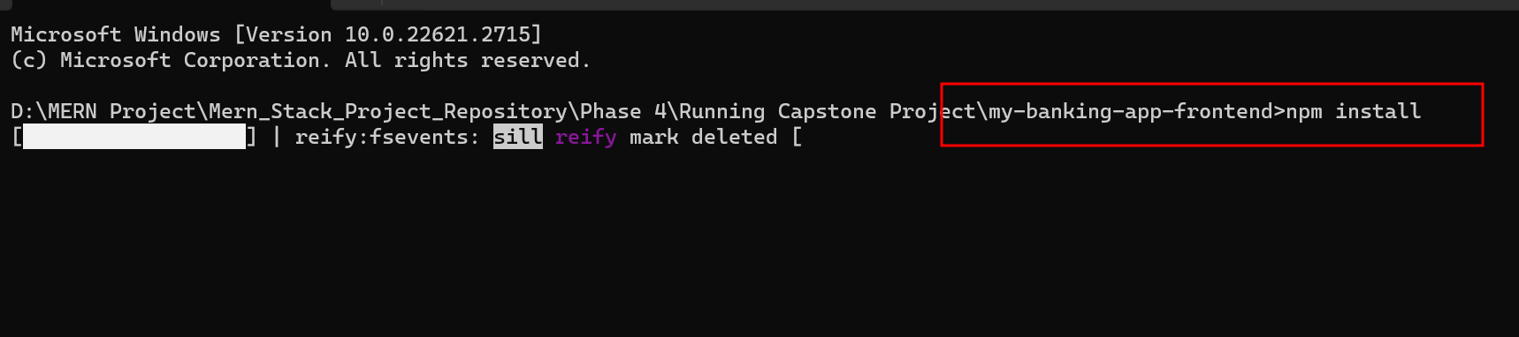
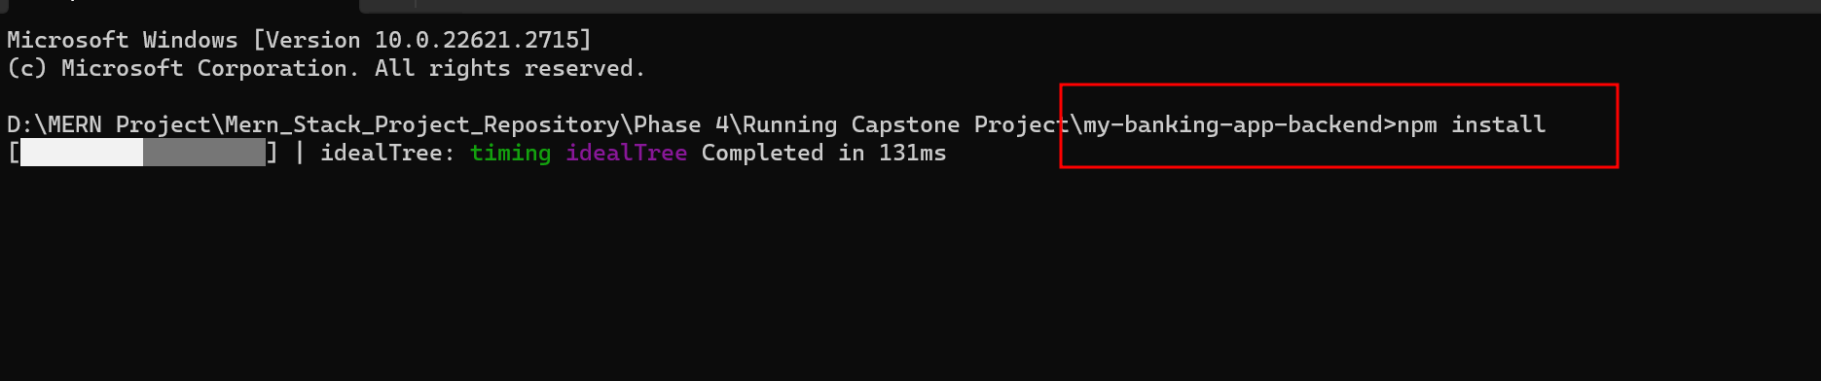
In both backend and frontend project
You run the npm install command to download the dependencies.

Slide 4
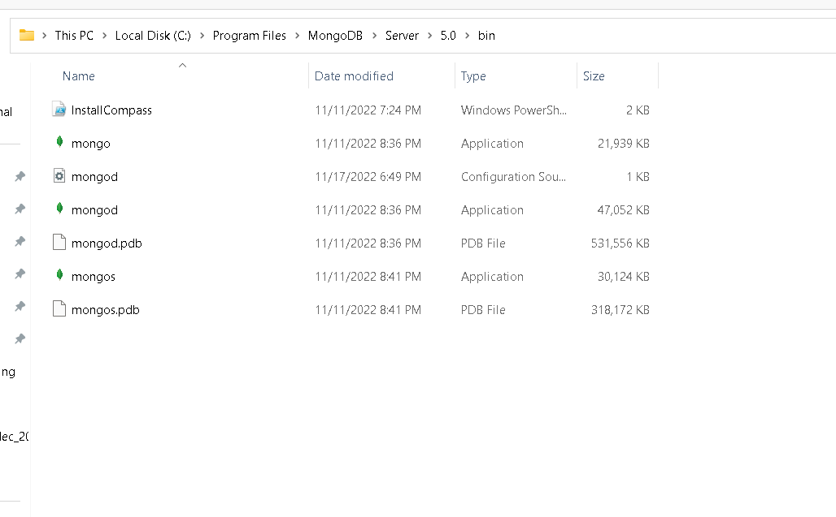
First install mongo db in your machine or vm machine

Slide 5
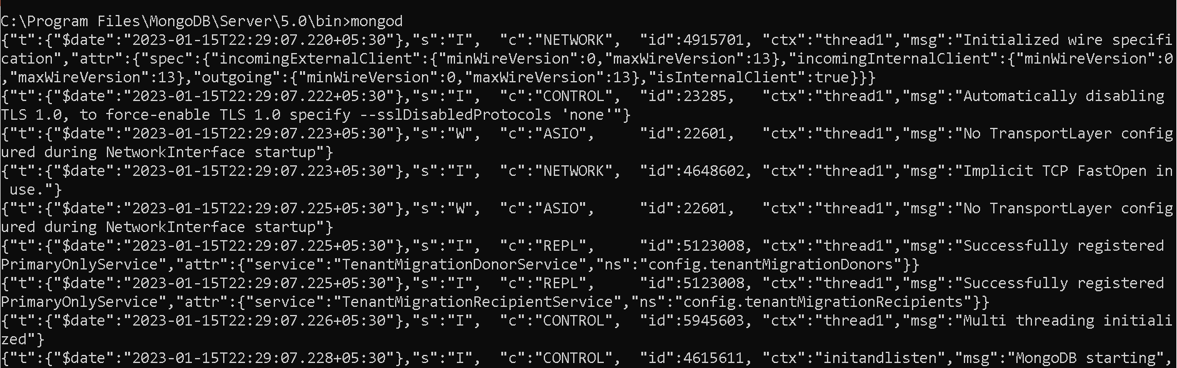
First run mongo db database this is optional

Slide 6
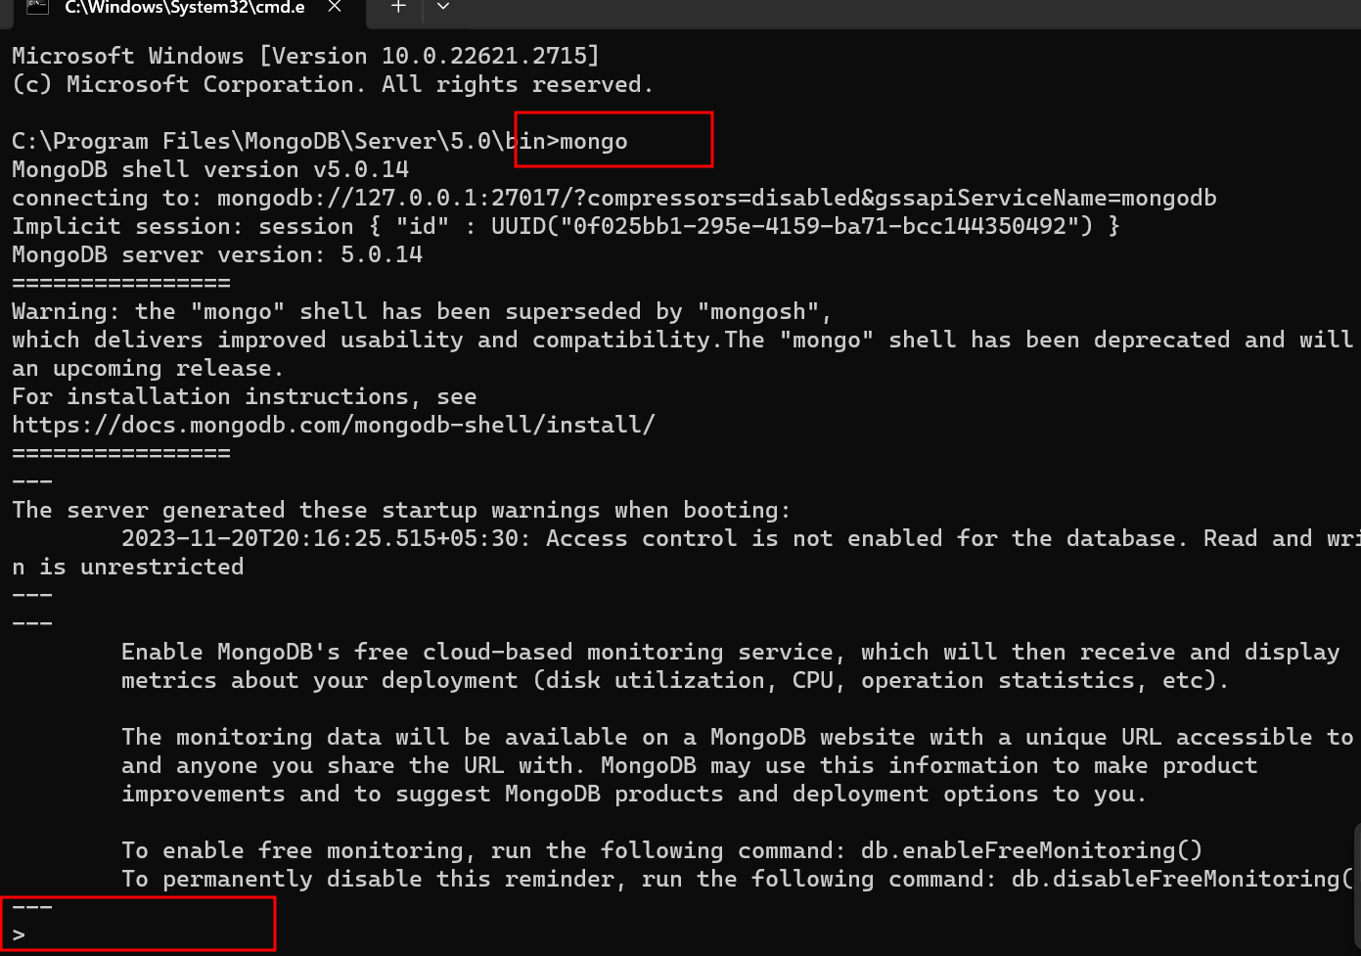
Run mongo terminal

Slide 7
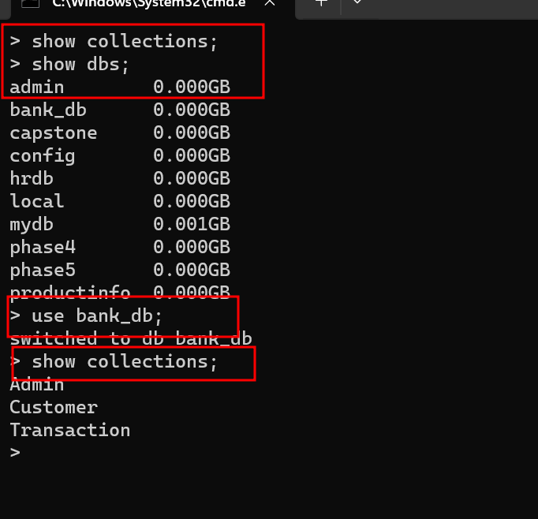
In mongo db database in terminal

Slide 8
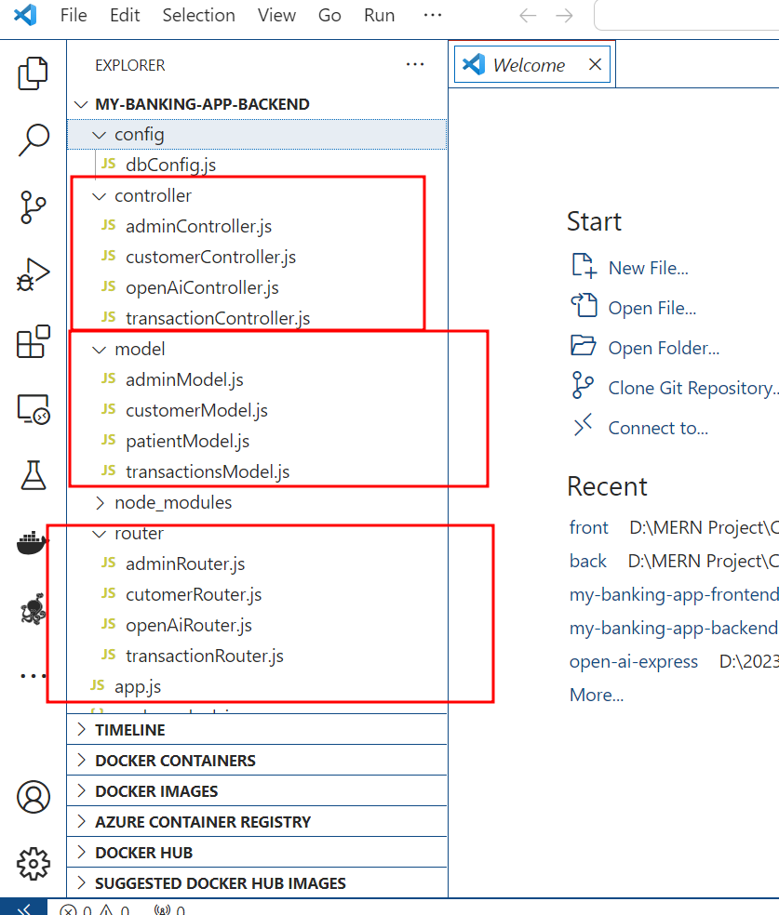
Now open express js project structure

Slide 9
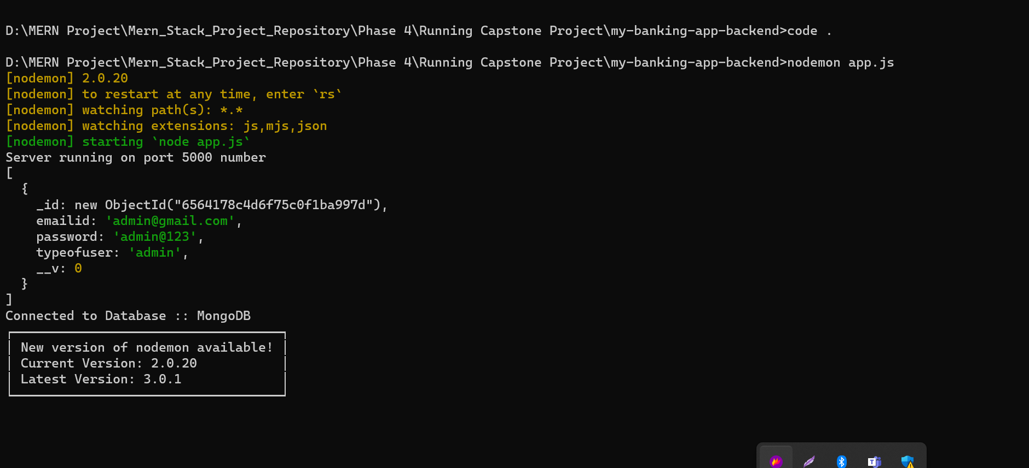
Now we run this application using command as After run successfully it will create admin account as admin@gmail.com and password as admin@123
node app.js or nodemon app.js

Slide 10
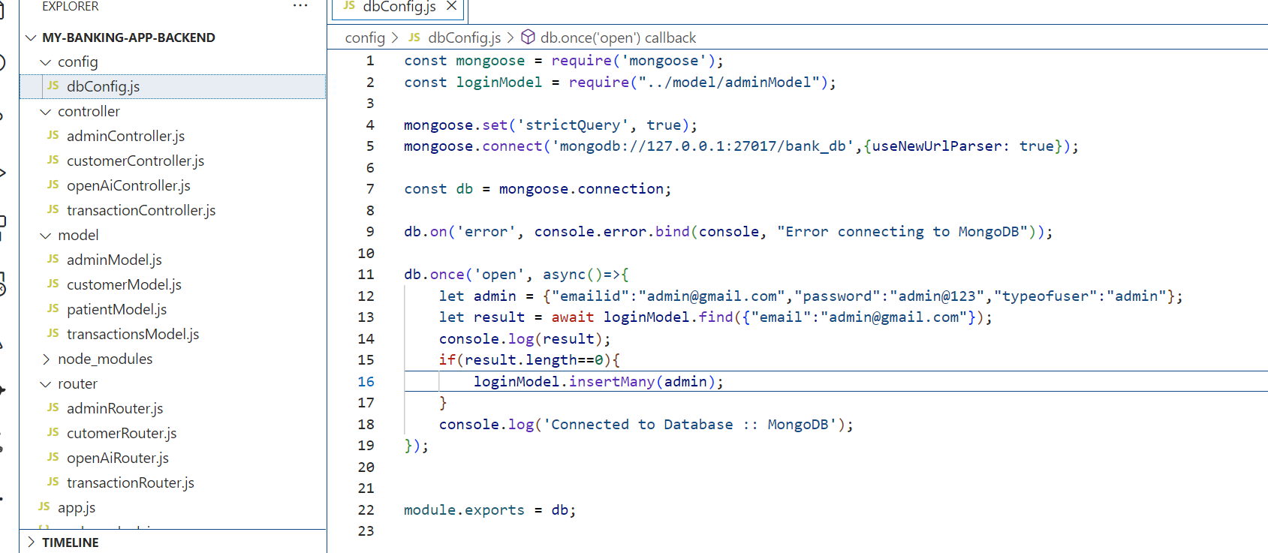
Sample dbConfig.js: it will connect database and create admin account

Slide 11
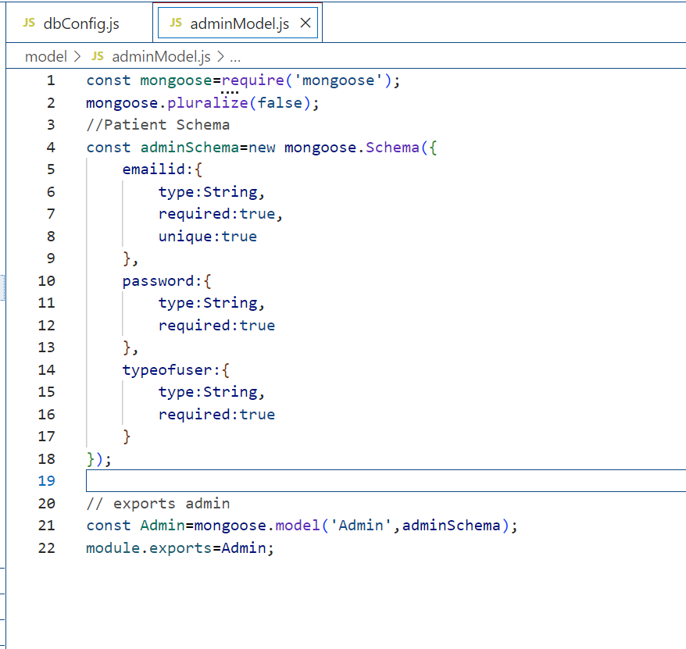
adminModel.js

Slide 12
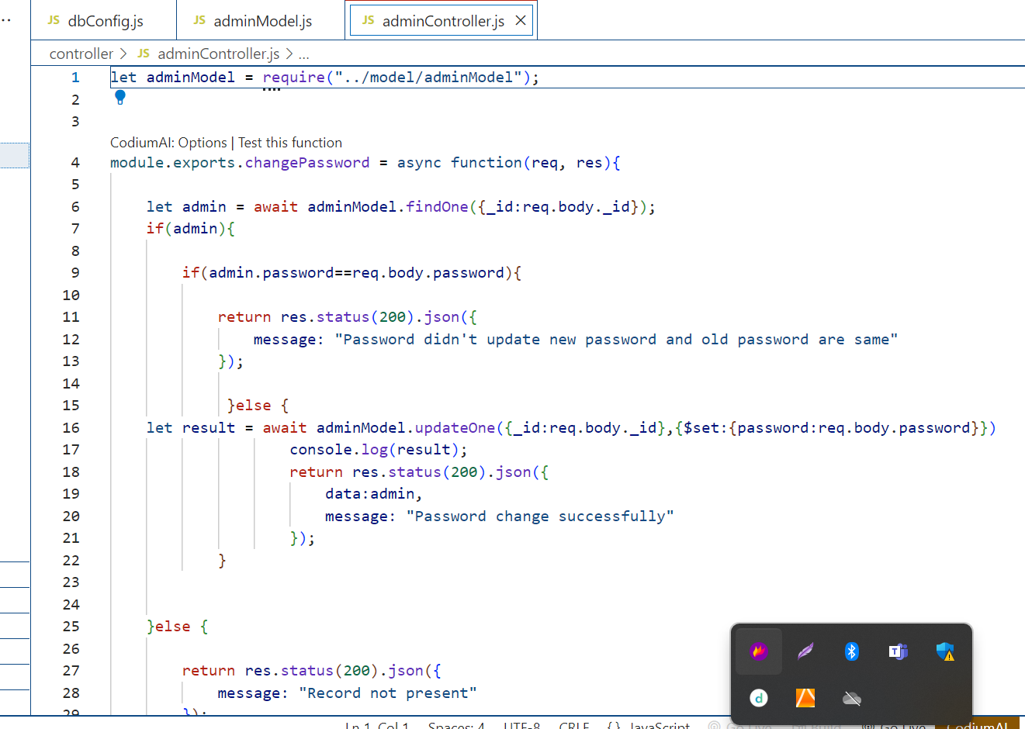
adminController.js

Slide 13
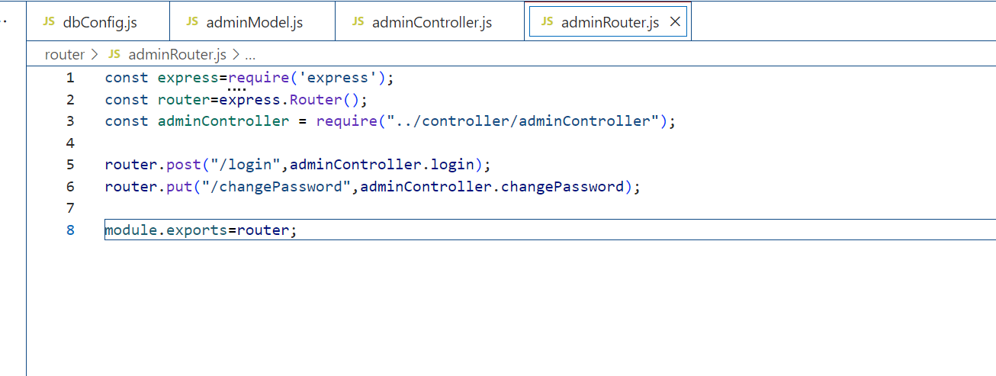
adminRouter.js

Slide 14
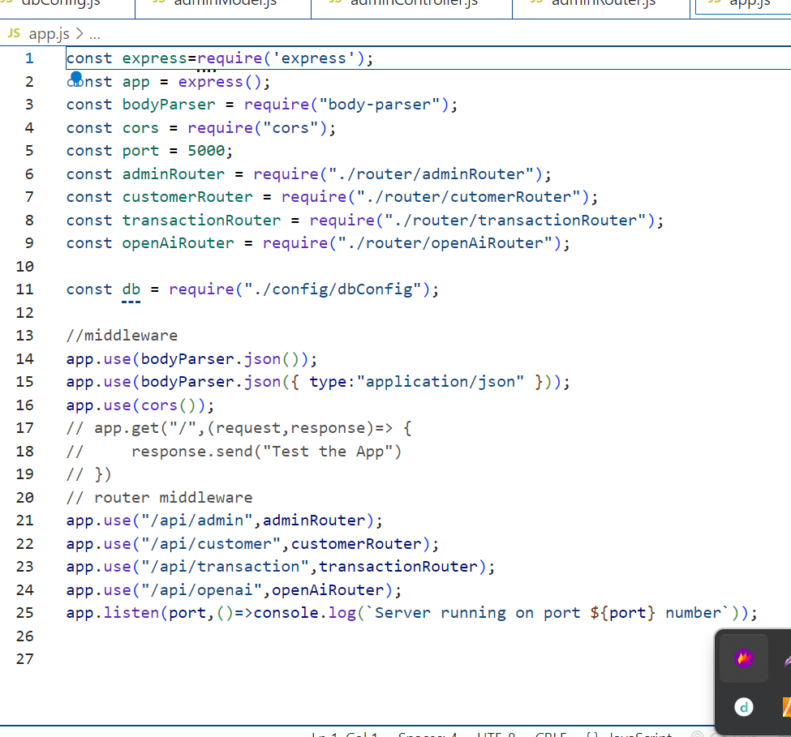
App.js

Slide 15
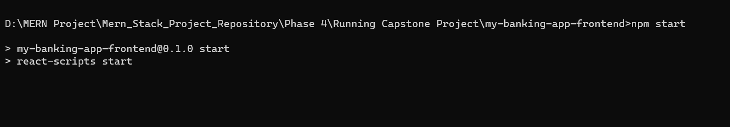
Run the react js project
npm start (project name is my-banking-app-frontend)

Slide 16
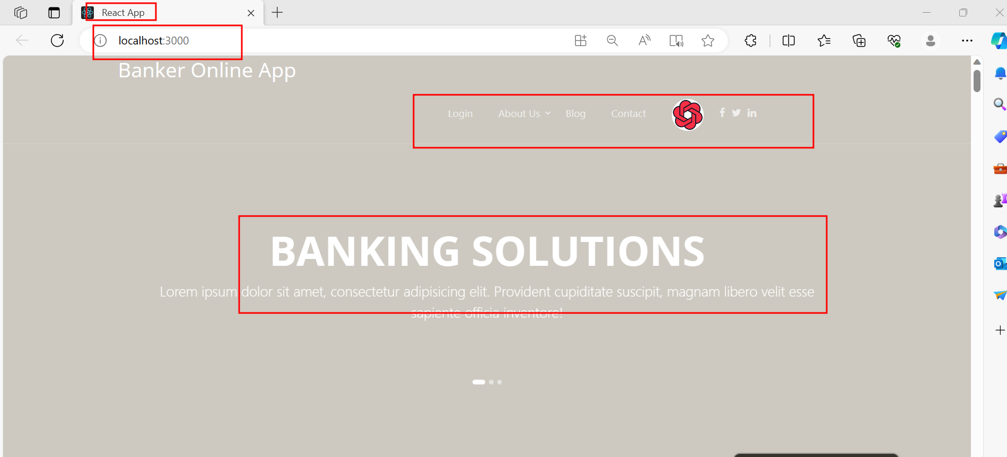
Online banking application landing page

Slide 17
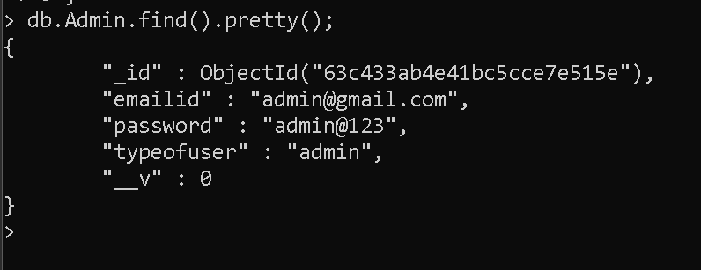
Mongo db collection in admin

Slide 18
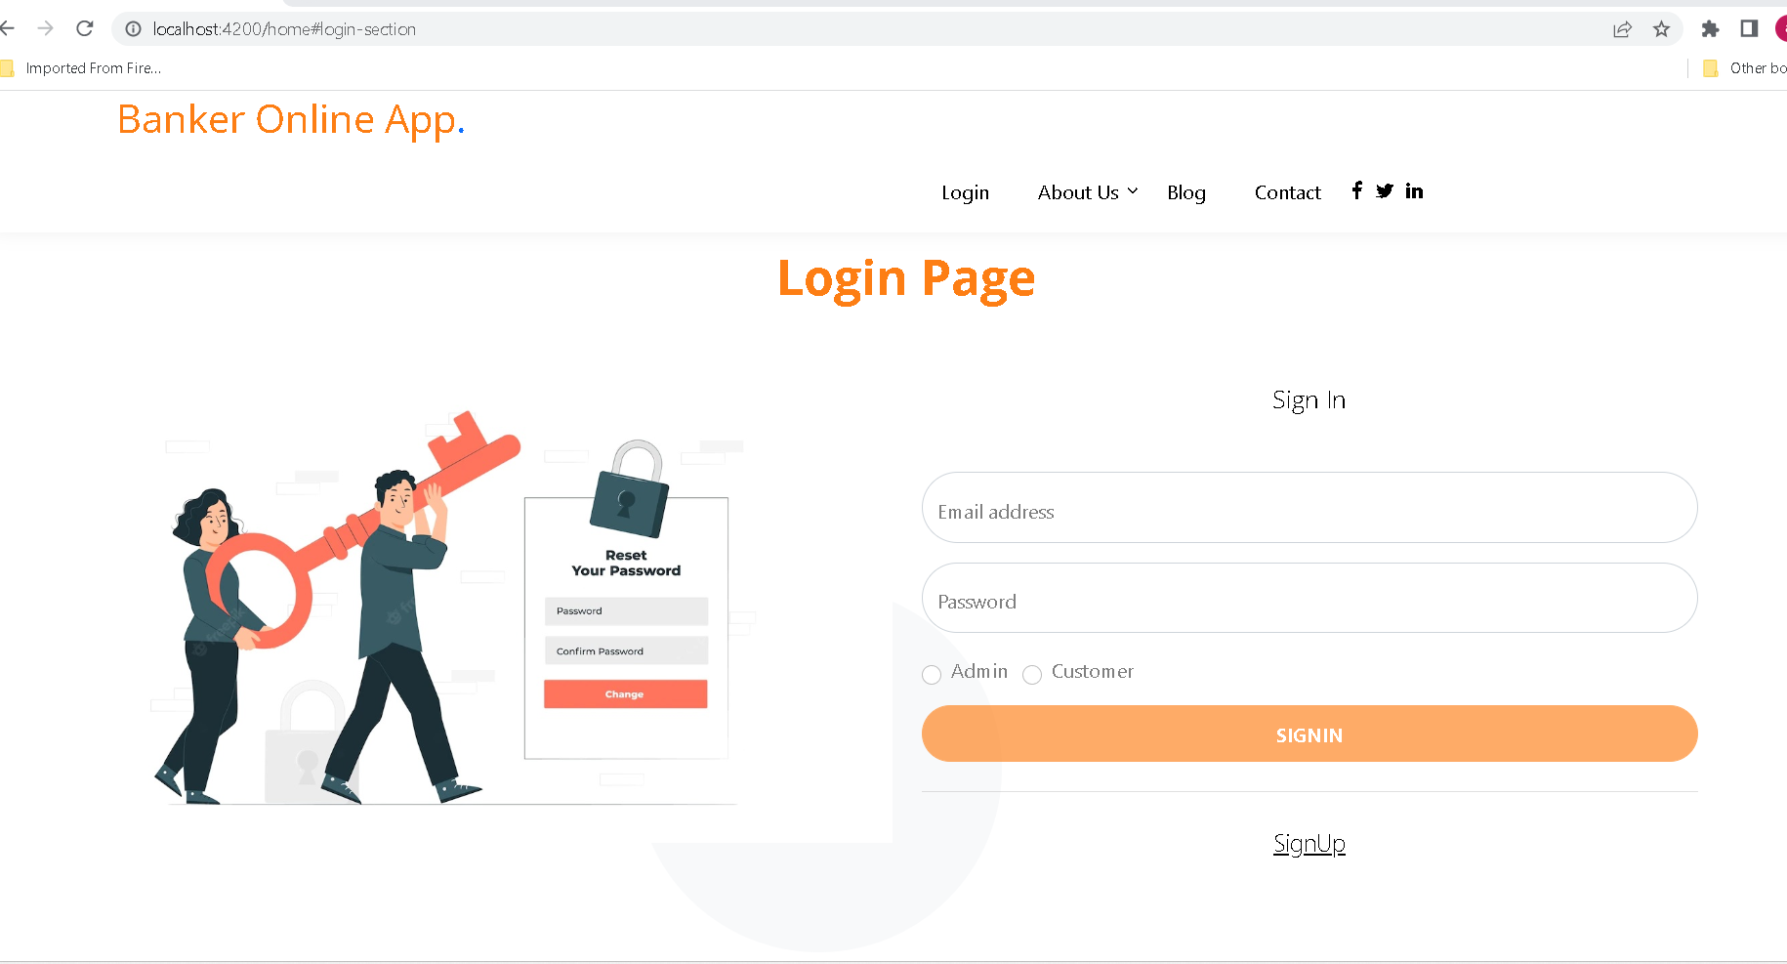
After click on login

Slide 19
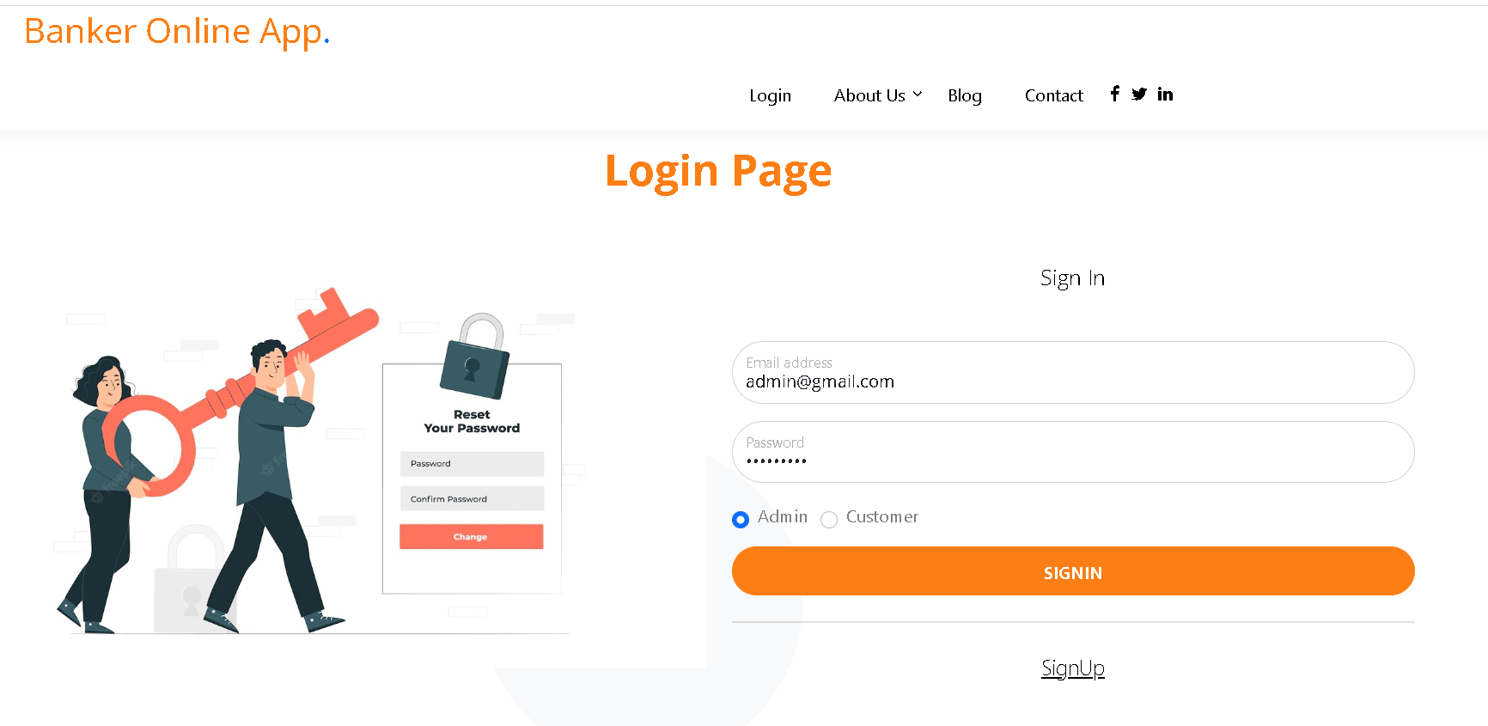

Slide 20
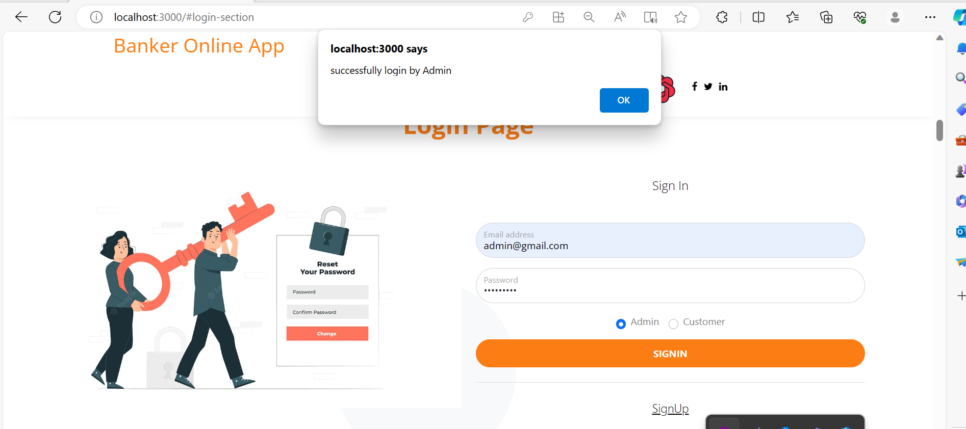

Slide 21
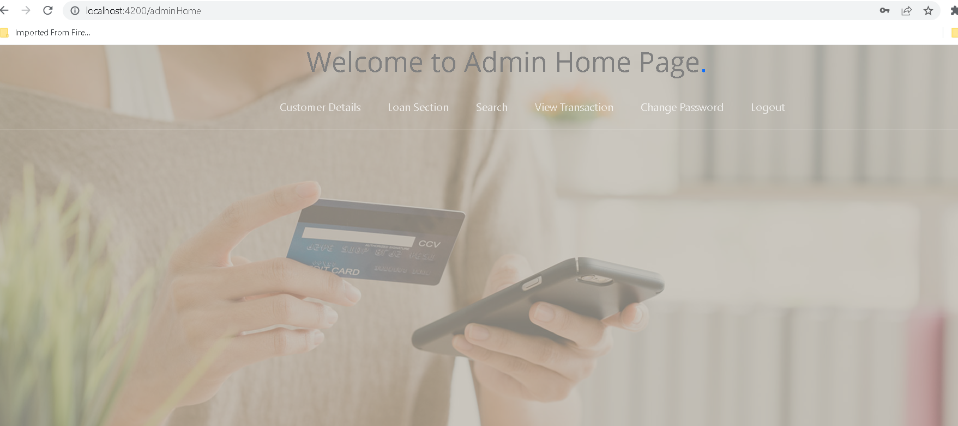
Admin home page

Slide 22
Now click on logout

Slide 23
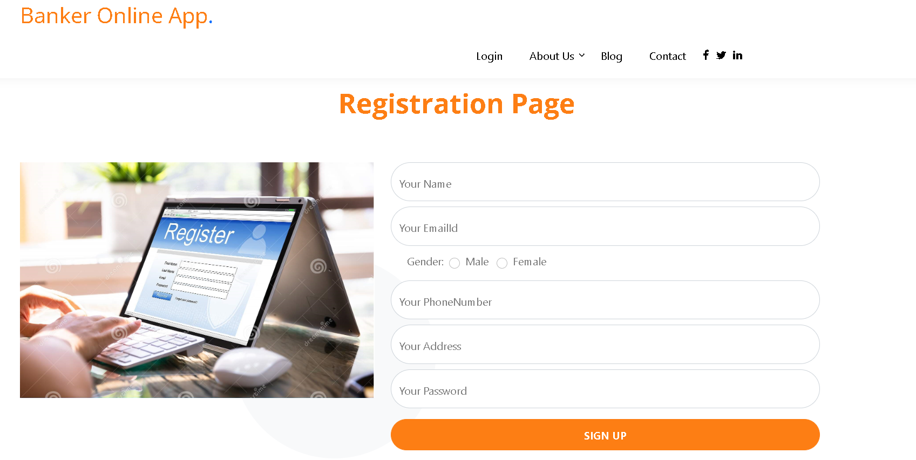
Now we will create the customer account. So click on signup

Slide 24
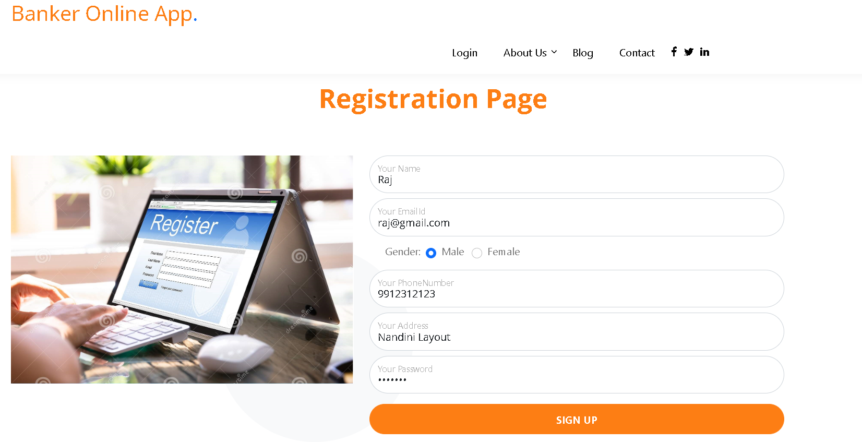
After fill the details

Slide 25
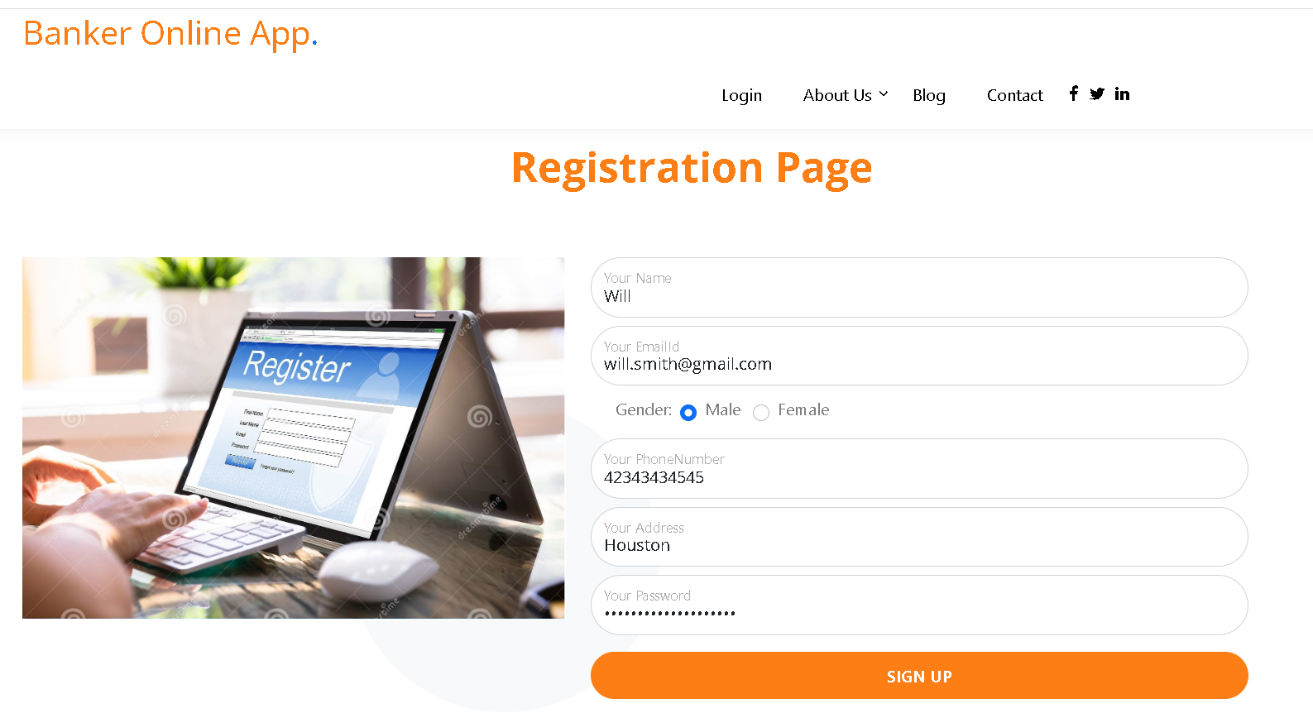
After fill all details

Slide 26
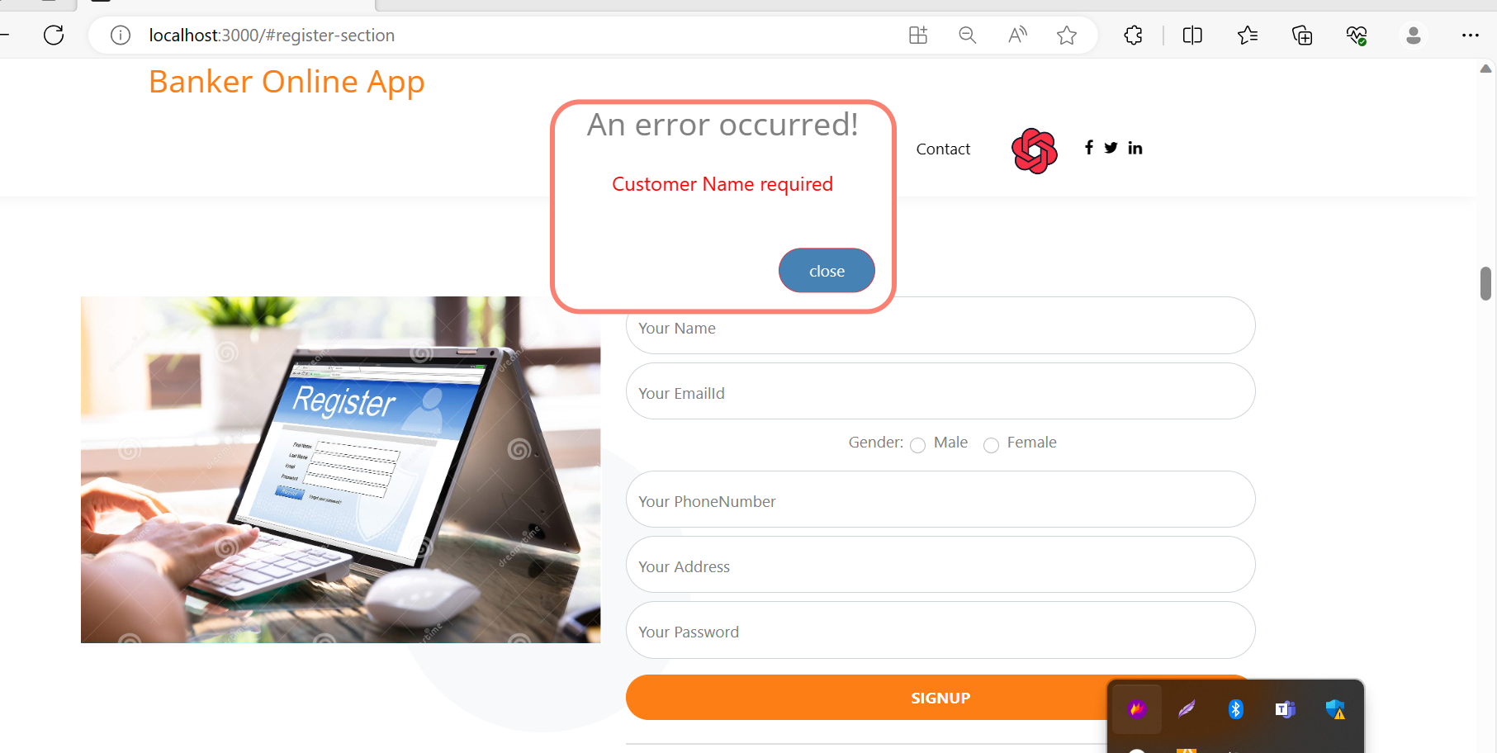
After created account now we can do login

Slide 27
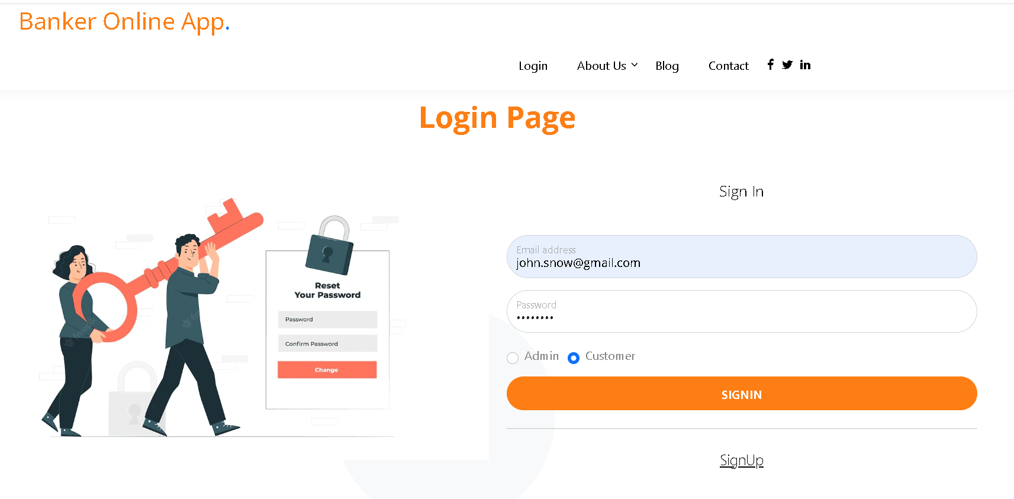
After fill customer login details

Slide 28
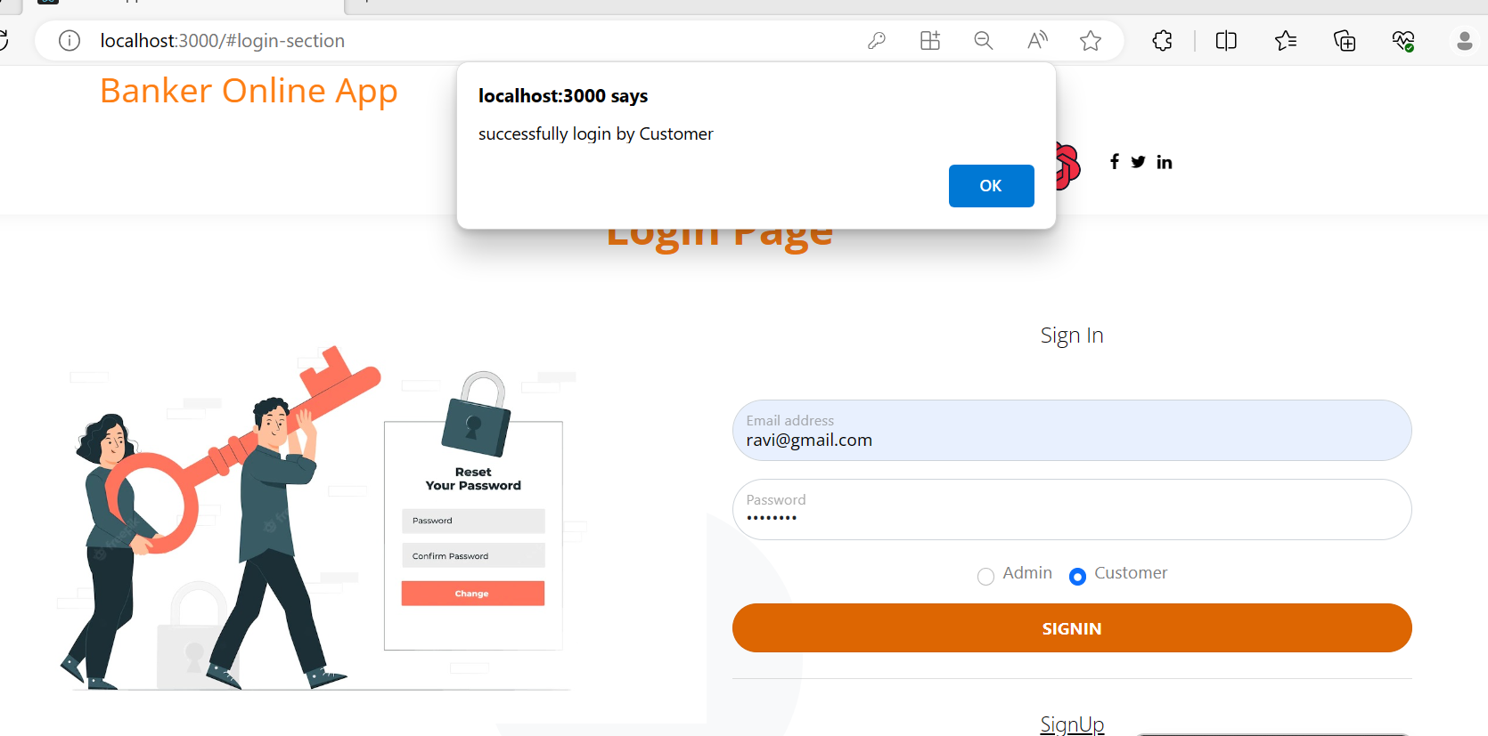
After customer login successfully

Slide 29
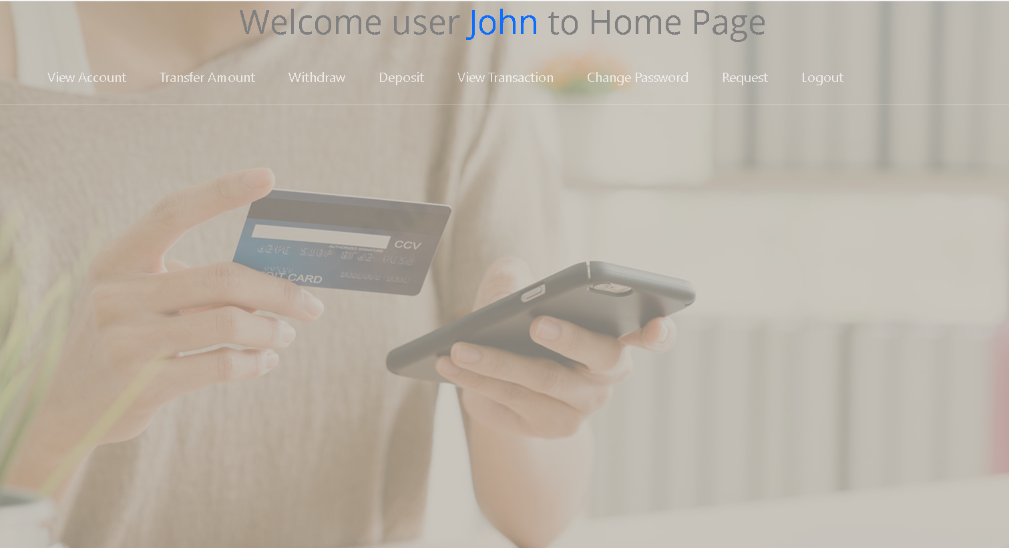
Customer home page

Slide 30
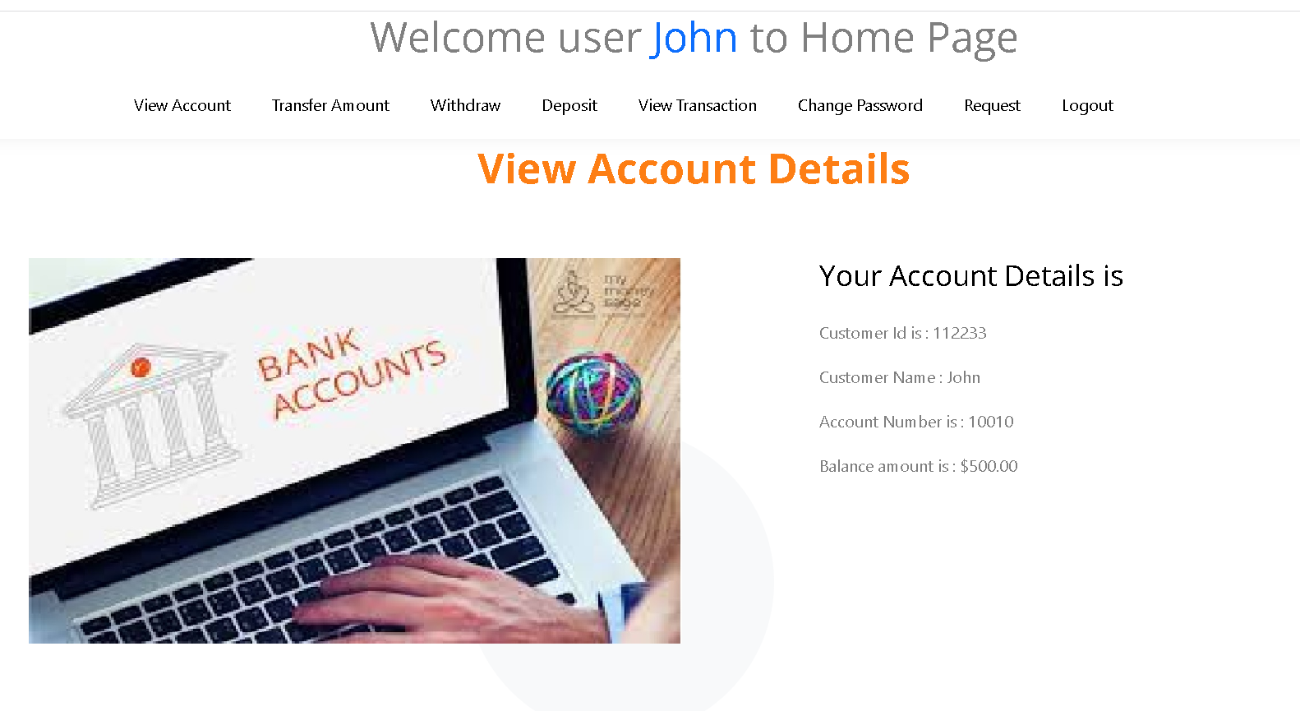
Customer account details – View account

Slide 31
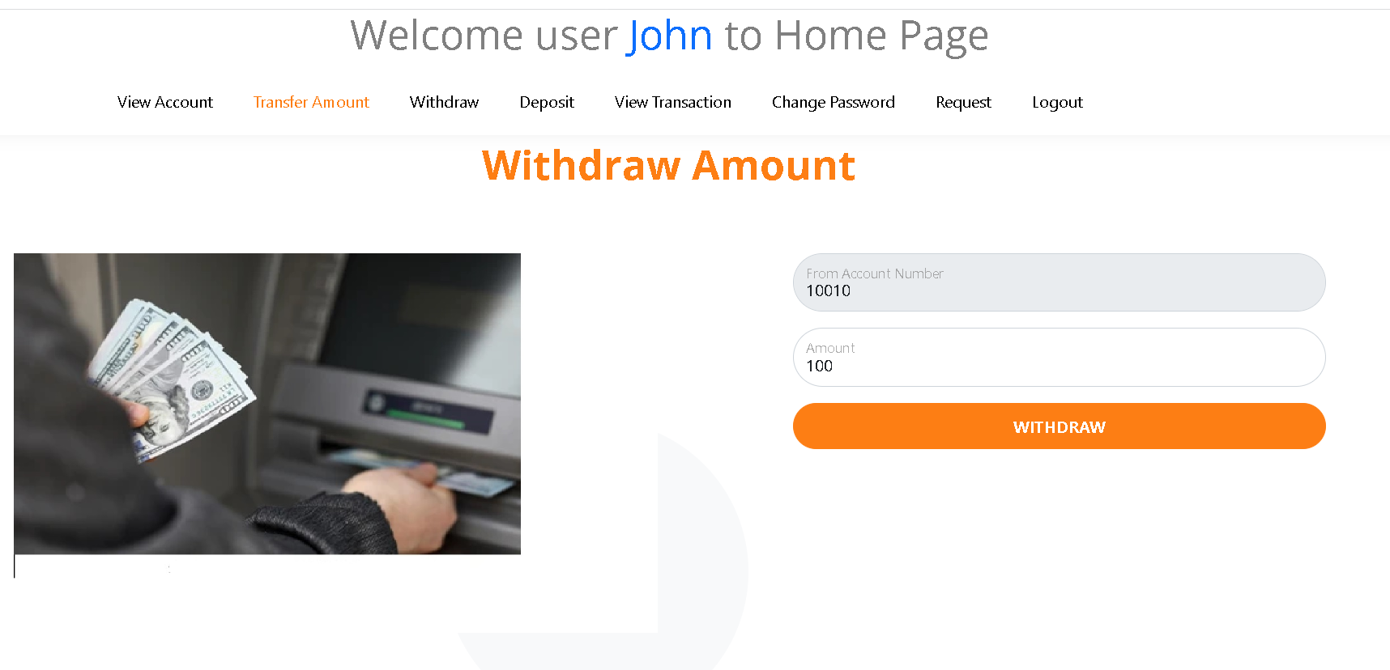
Withdraw amount

Slide 32
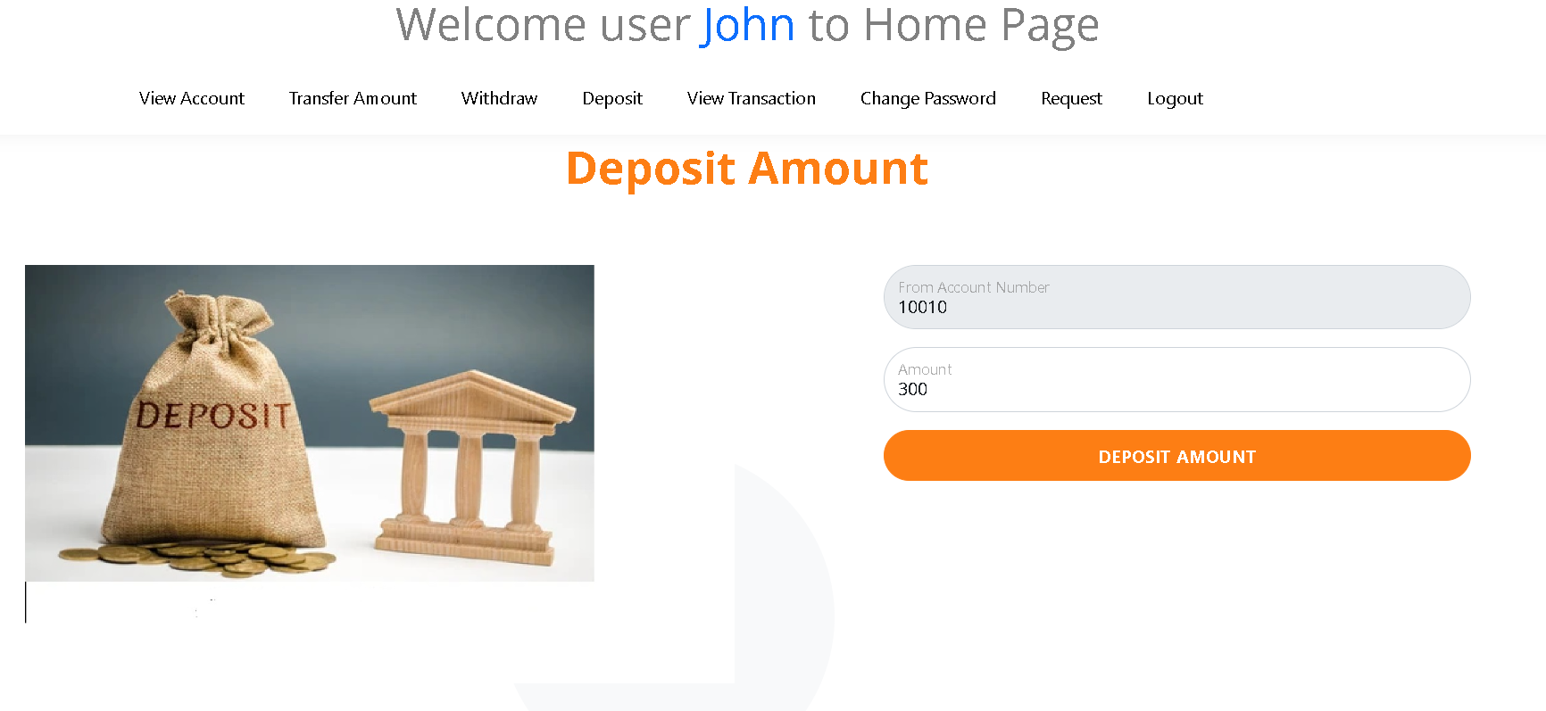
Deposit amount

Slide 33
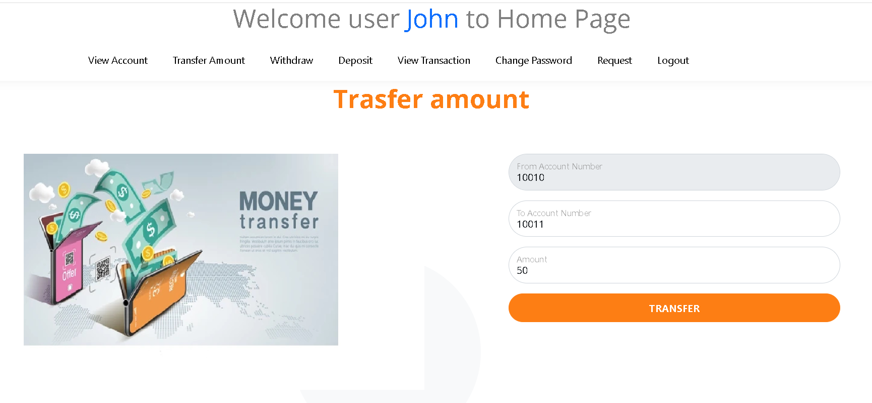
Transfer amount

Slide 34
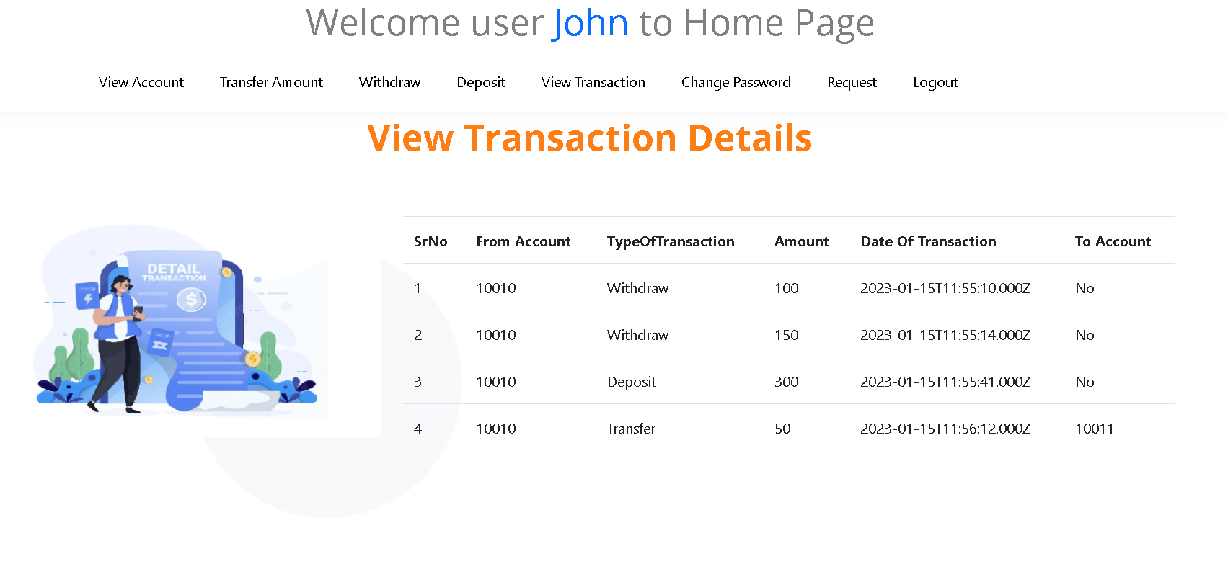
View its own transaction details

Slide 35
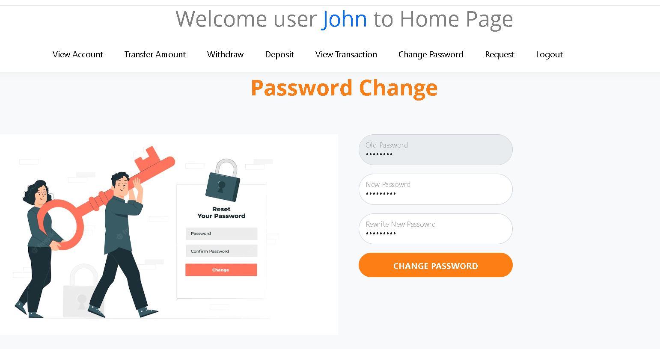
Customer change password

Slide 36
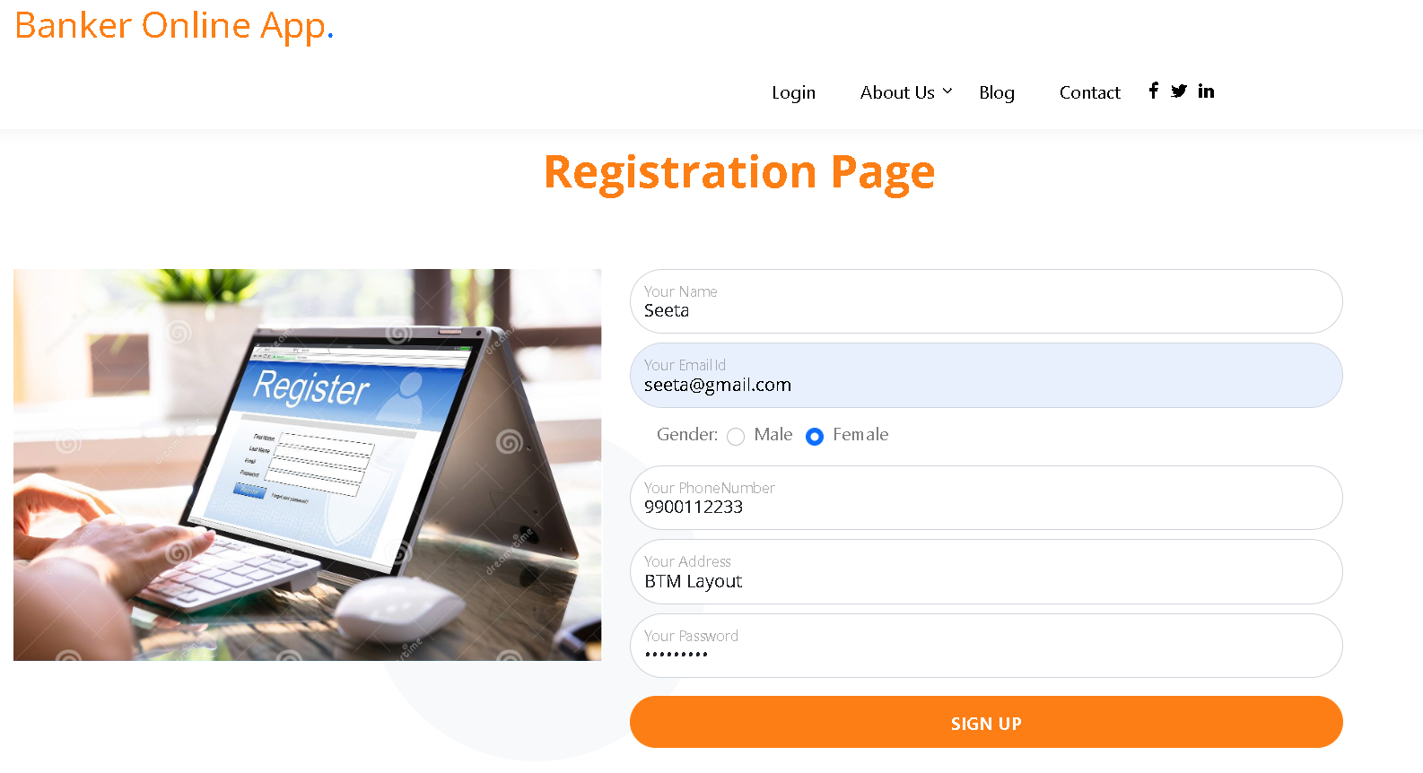
We will create more than one account

Slide 37
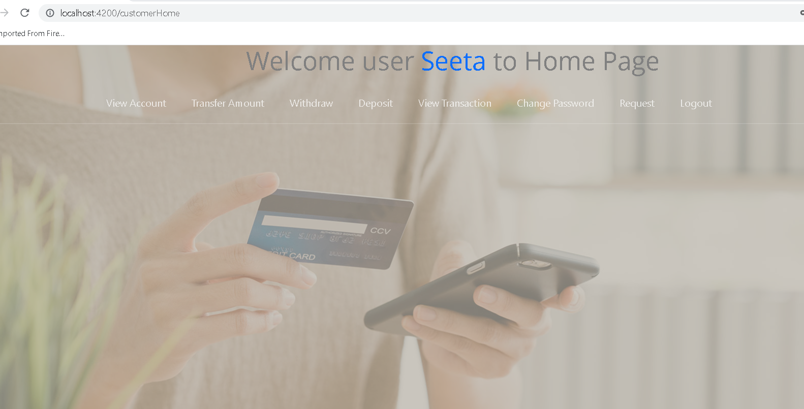
Login with another account

Slide 38
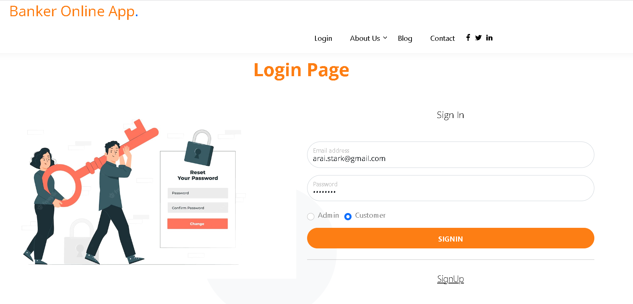
Login with another account

Slide 39
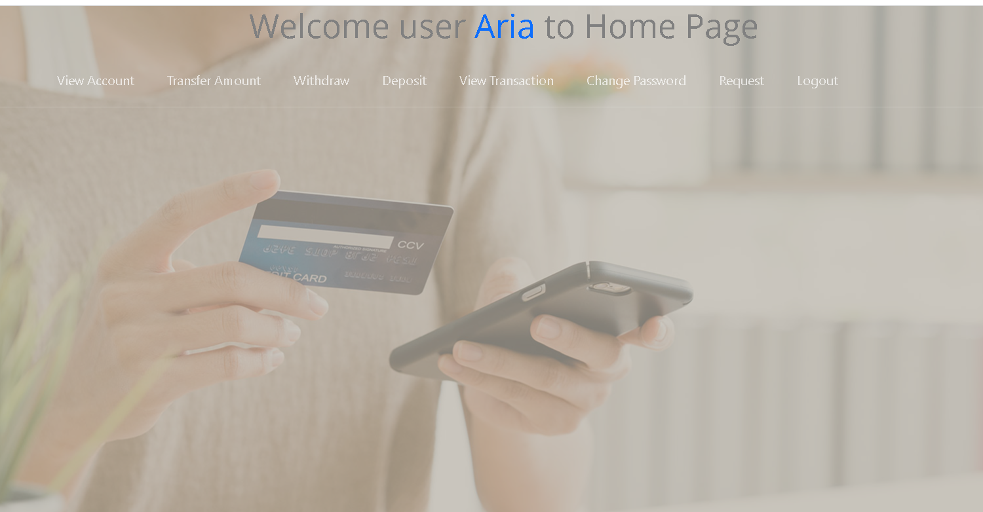
View its own details

Slide 40
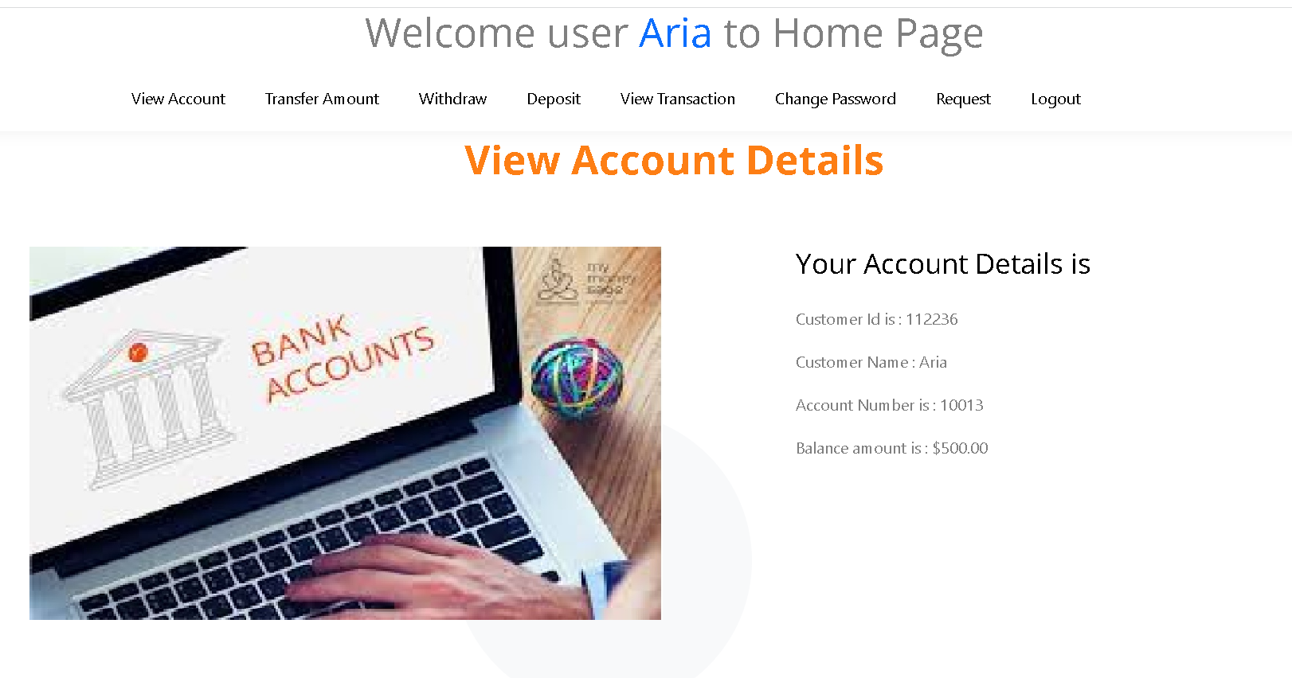
View its own account

Slide 41
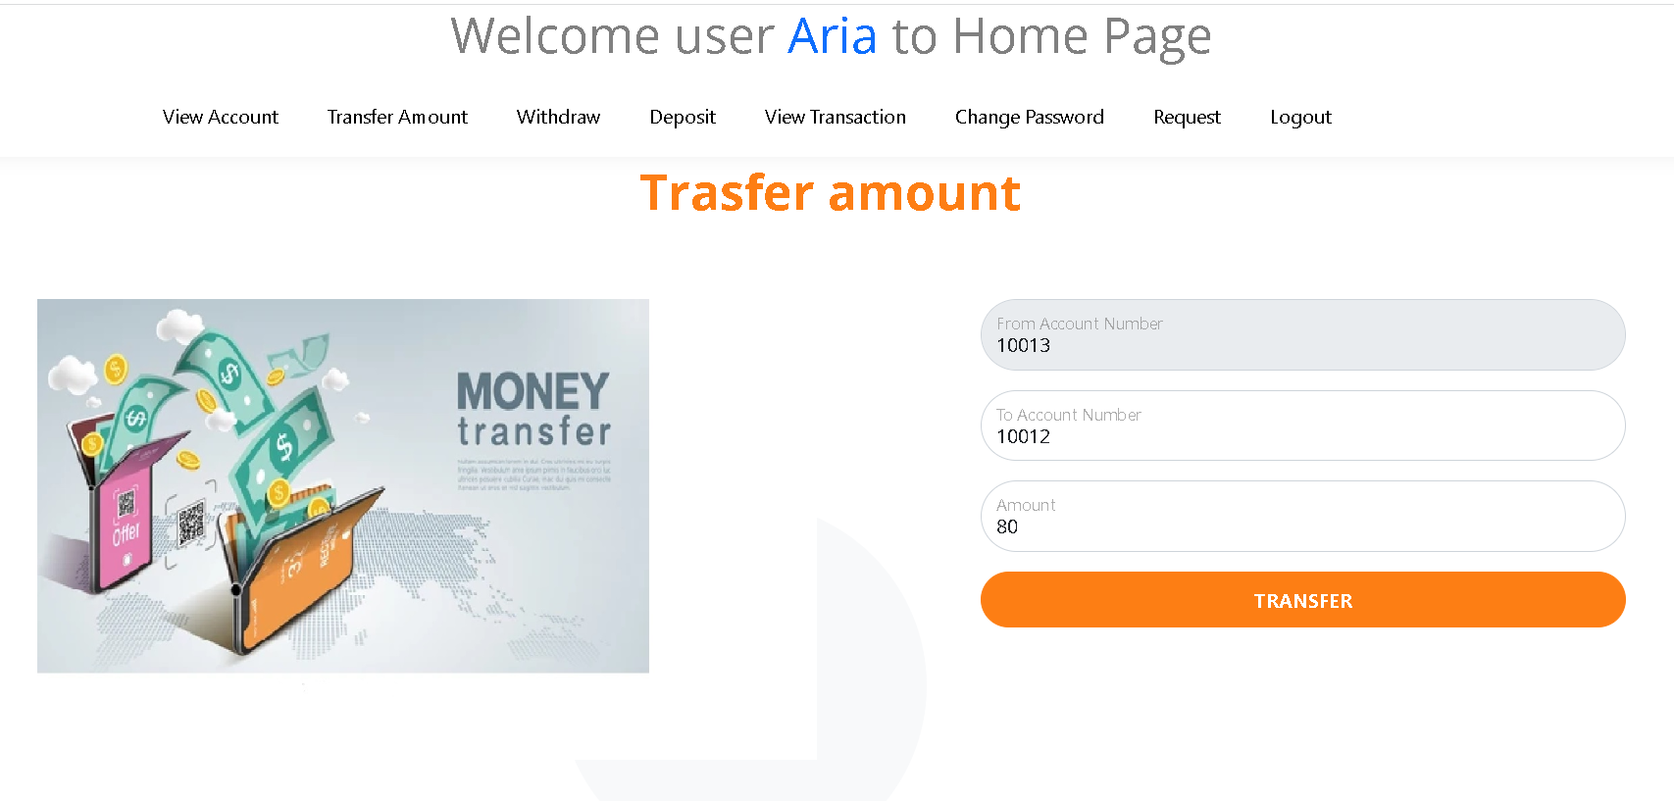
Do more withdraw and deposit operation

Slide 42
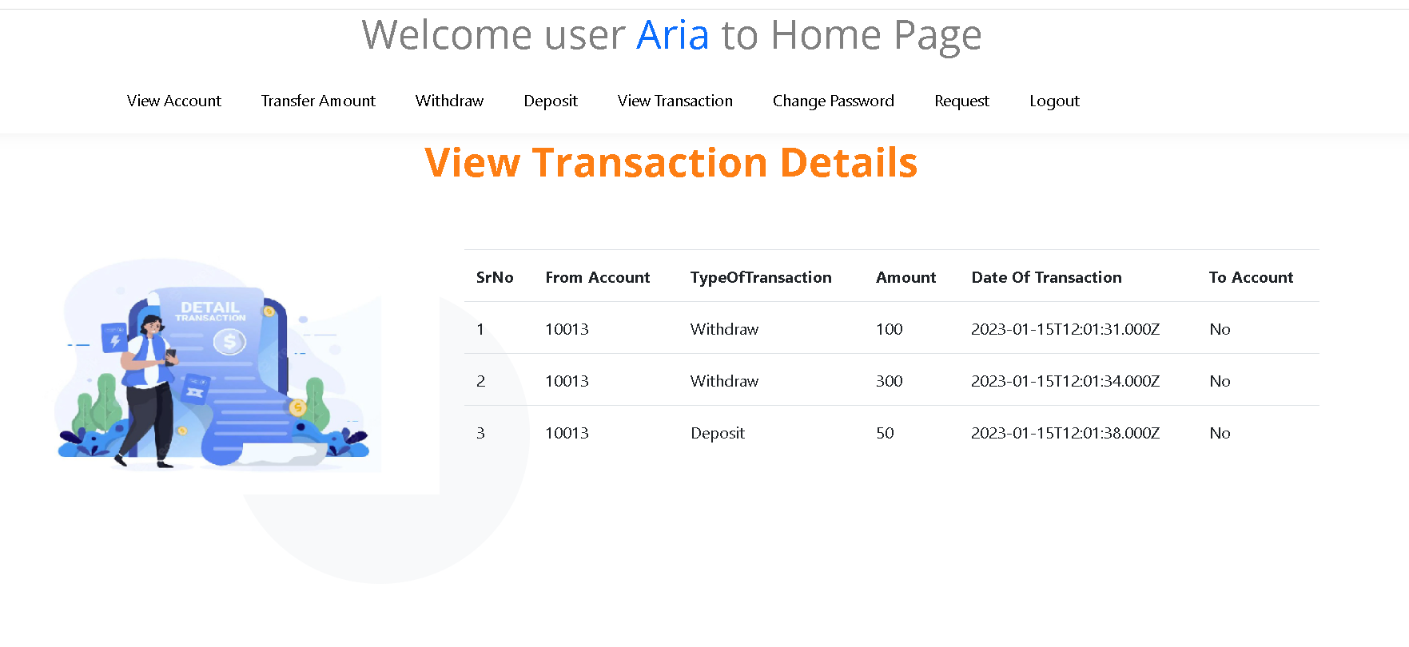
To check its own transaction details

Slide 43
Now we do the login using admin
username : admin@gmail.com
password : admin@123

Slide 44
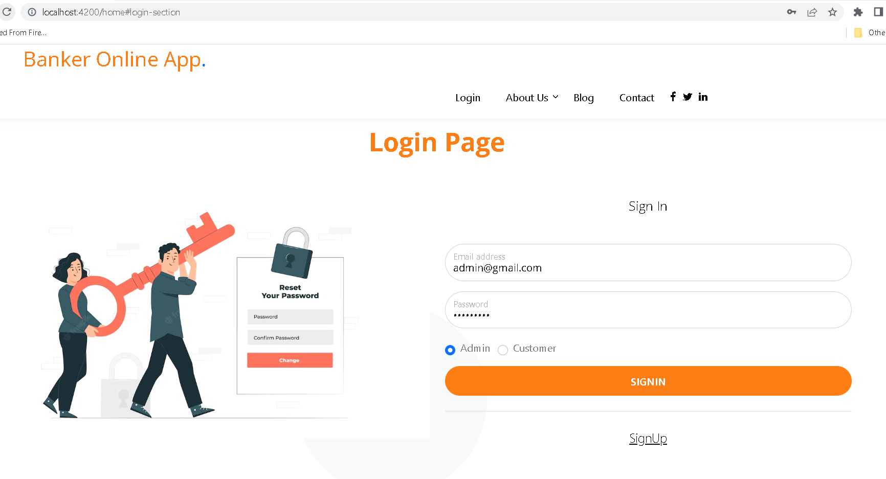

Slide 45
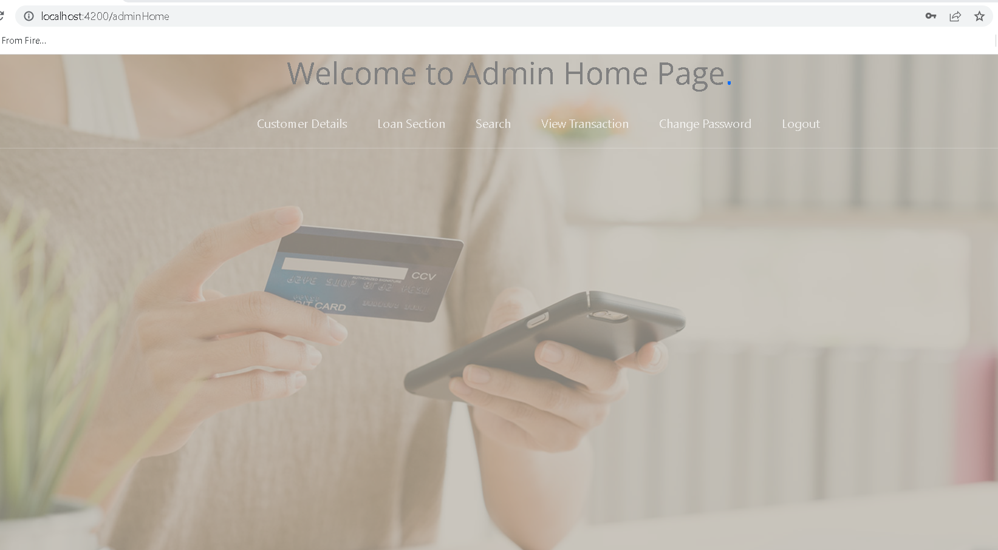
Admin dashboard

Slide 46
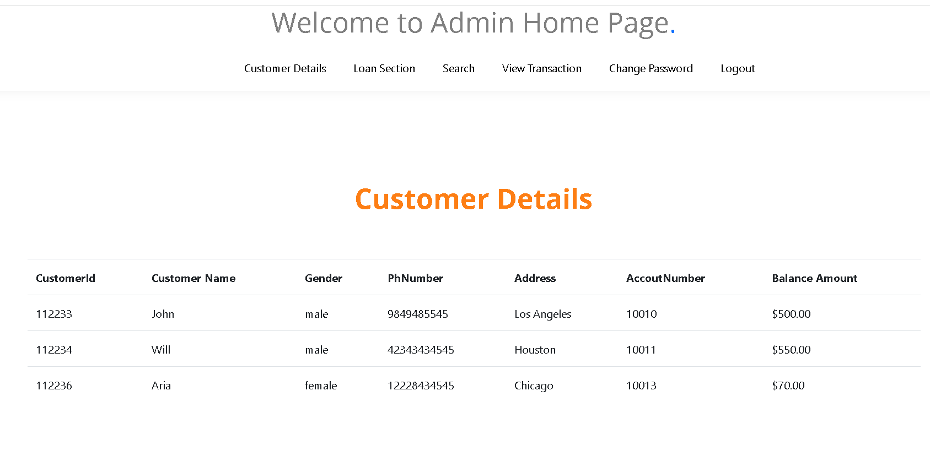
View all customer details

Slide 47
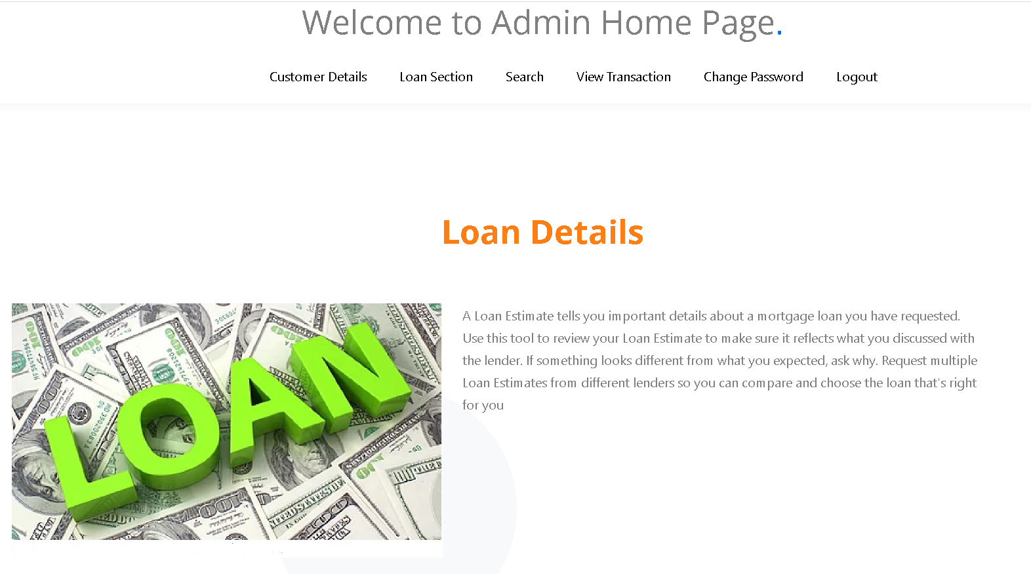
Loan section - static web page

Slide 48
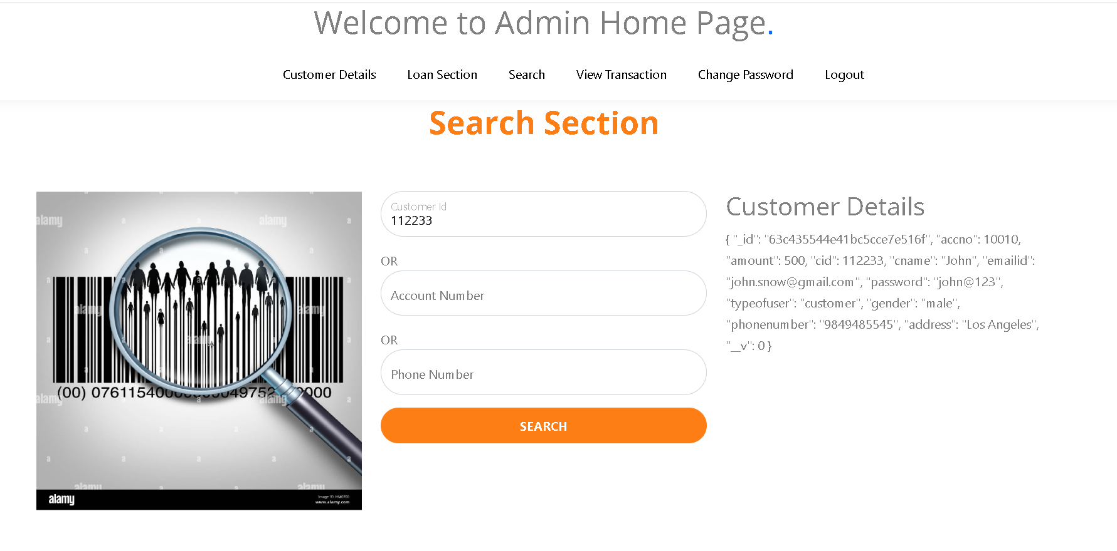
Search customer
By : customer id

Slide 49
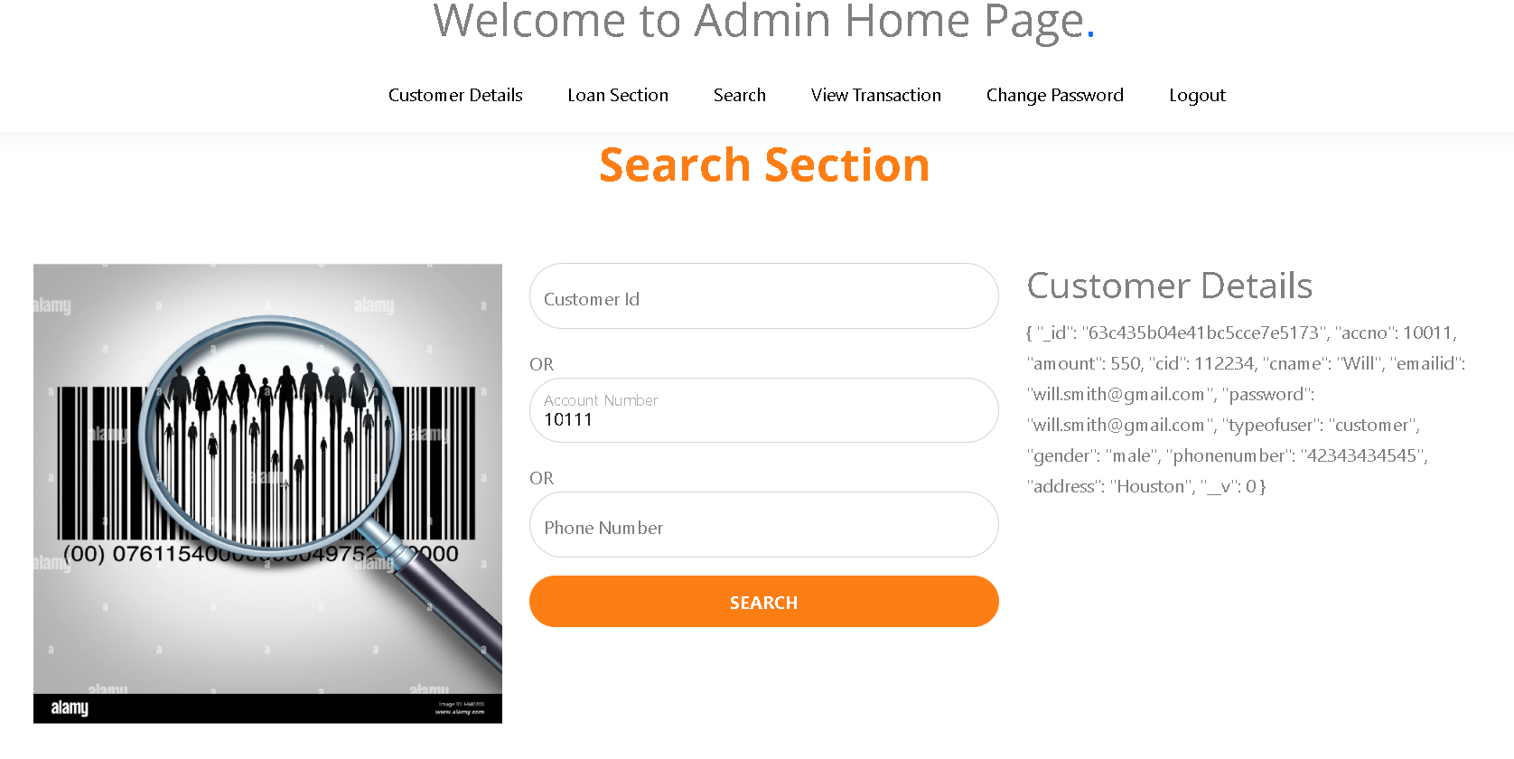
Search customer
By account number

Slide 50
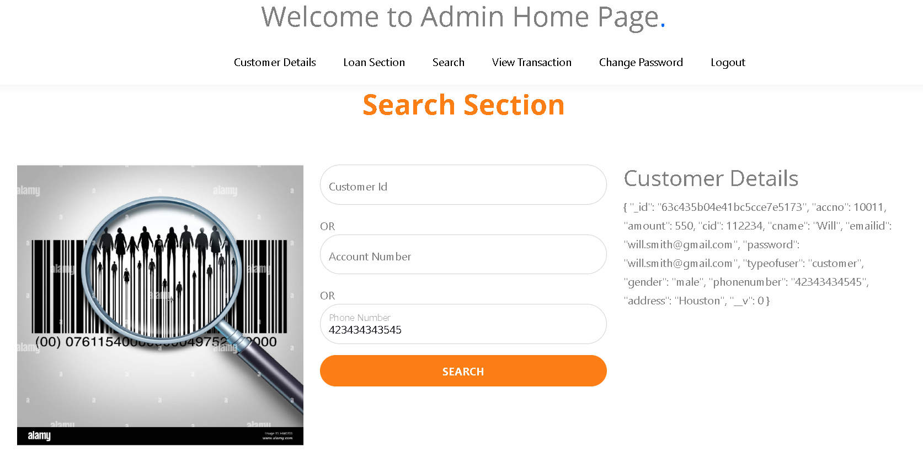
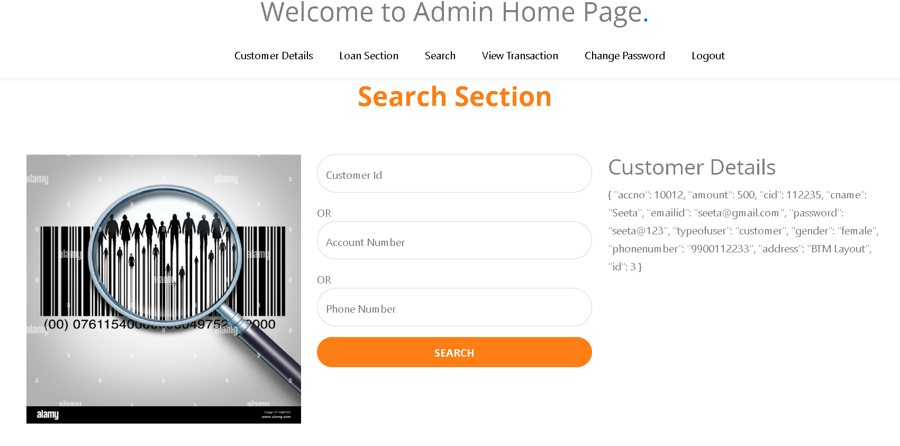
Search customer
By phone number

Slide 51
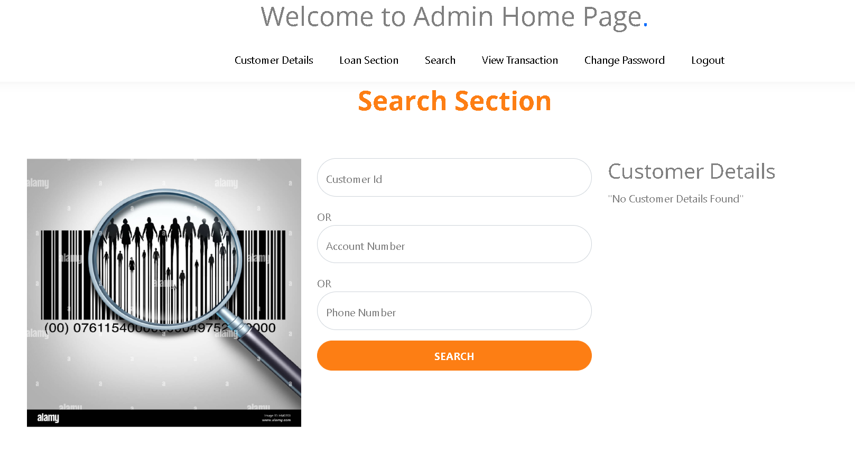
Search customer – not available

Slide 52

View all customer details

Slide 53

Change password

Slide 54

You can view without login any another information using openai so click on open ai icon

Slide 55

After click

Slide 56

Before search you need to create to token. Please open the file as openAiController.js

Slide 57

https://platform.openai.com/
Copy and paste token in file.

Slide 58
Please copy and paste token in this file

Slide 59

Write any information you want to search

Slide 60

It will display as

Slide 61


Slide 62


Slide 63

The banked logic written using as openai express js module

Slide 64
View all collection in mongo db database

Slide 65

db.Customer.find().pretty()

Slide 66

db.Admin.find().pretty()

Slide 67

db.Transaction.find().pretty();

